Slide 1
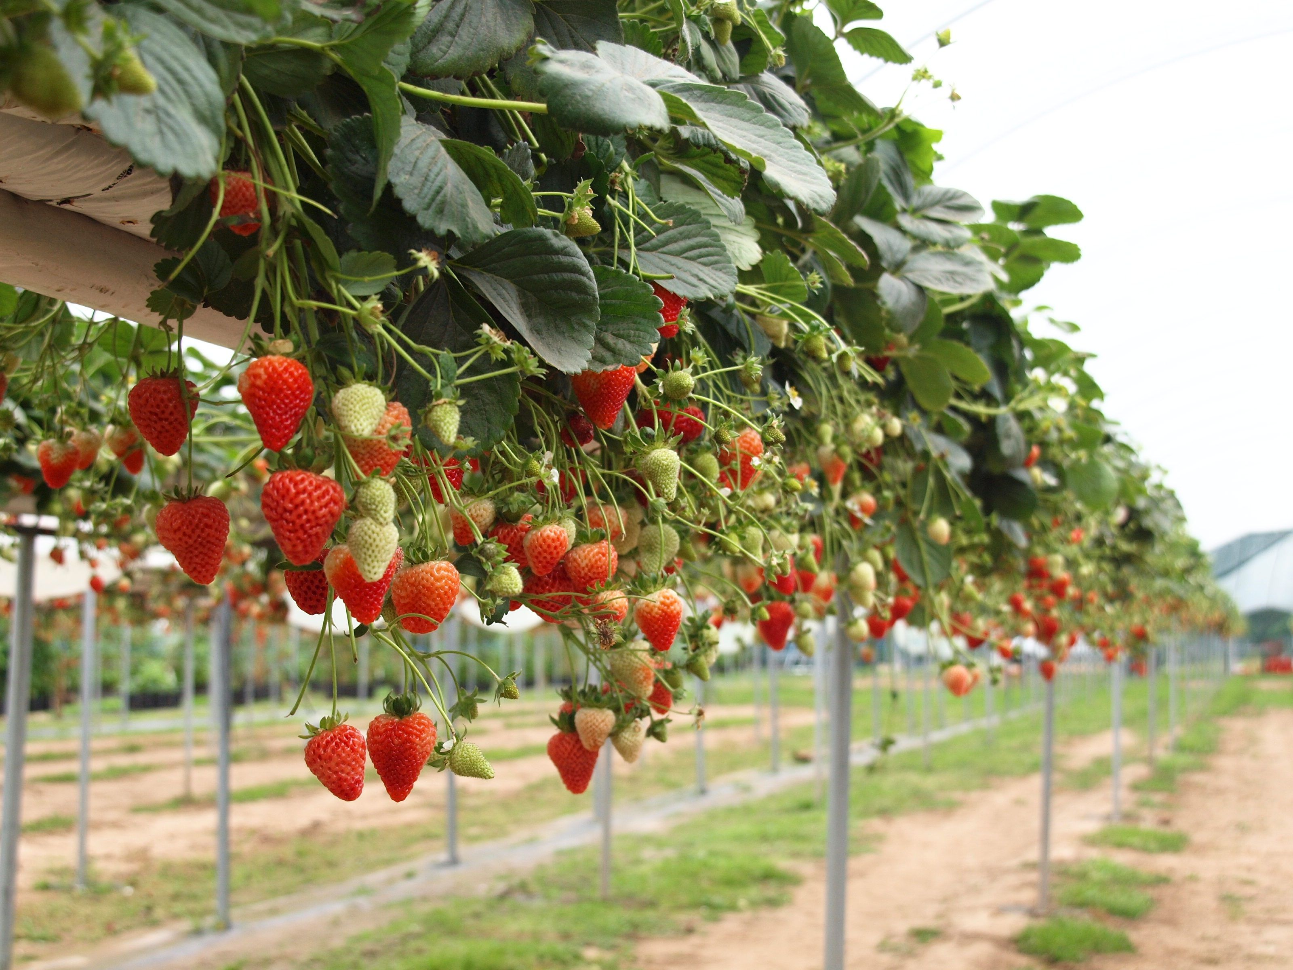
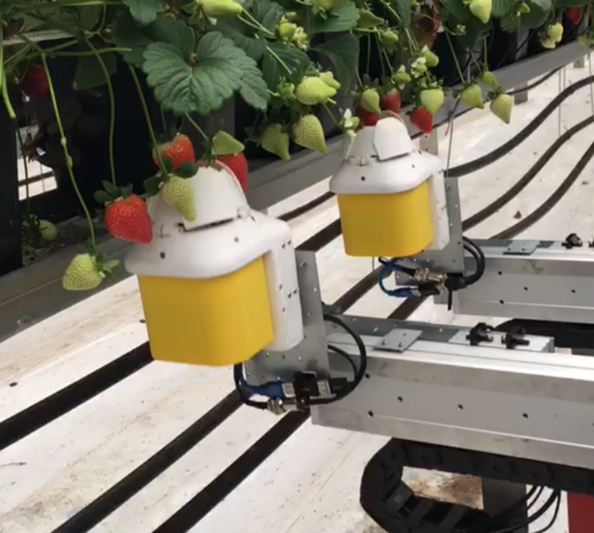
Software Engineer NORONN is an ambitious start-up based in Norway and scaling up for commercialisation. We are looking for a software engineer to join our highly competent team. The right candidate will play an important role in making the worlds fastest and most efficient automatic strawberry harvester ready for the international market. Our solution is based on advanced Robotics, Artificial Intelligence and Deep learning.
Position descriptions:
This is a 1-year full-time position to participate in developing a robotic strawberry harvester. The ambitions is to do full-scale testing, validation and make a go-to-market strategy. There is a possibility of extending the contract after the one year period.
Main task:
Training and running a 3D convolutional neural network for strawberry detection and localization. Industrial-level software design and development for strawberry harvesting robots, including the improvement on the current software, and design and integration of more efficient and robust system. User-friendly interface design
Qualification requirements:
BSc or MSc degree in software engineering, computer science or robotics.
Proficiency in C++ and Python
Desired experience in ROS, PCL and OpenCV
Experience in development of industrial-level products
Good communication in English
Compensation and benefits
Annual salary 420.000-480.000 NOK (gross) depending on experience.
Enrolled in Norwegian pension and health benefits.
Be one of the very first employees in a newly formed company.
Applications is welcomed as soon as possible to katharina.asting@innokra.com,
For questions contact Pål Johan From + 47 906 90 932, or Katharina Asting + 47 918 08 417

